Slide 1

Graphics Recognition A Historical Perspective and Recent Advances
Rangachar Kasturi
Computer Science and Engineering
University of South Florida
Tampa, Florida, USA
The copyright for the illustrations and other objects used in this presentation are owned by the respective copyright holders; they are included here to acknowledge their contributions to the Document Analysis and Recognition research.
Computer Vision and Pattern Recognition Laboratory
Notes:
Thank

Slide 2
IAPR/ICDAR Award
Sargur Srihari, Nominator
Lawrence O’Gorman, Endorser
Gabriella Sanniti di Baja, Endorser
Karl Tombre, Endorser
Computer Vision and Pattern Recognition Laboratory

Slide 3
IAPR/ICDAR Award Committee
Dimosthenis Karatzas (Award Chair)
Bart Lamiroy (Award Chair)
Dan Lopresti
Jean-Marc Ogier
Josep Llados
Simone Marinai
Cheng-Lin Liu
Marcus Liwicki
Venu Govindaraju
ICDAR 2017 Organizing Committee
Koichi Kise and Team
Computer Vision and Pattern Recognition Laboratory

Slide 4
IAPR/ICDAR Award
I would like to Dedicate this award to
My 70+ Students
Who Performed Much of the Research I am Recognized for
Over the Past 35 Years
Computer Vision and Pattern Recognition Laboratory

Slide 5
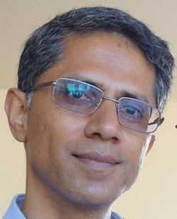

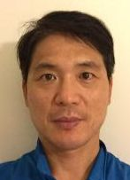
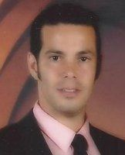
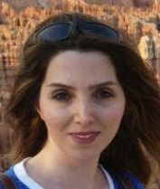


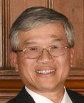
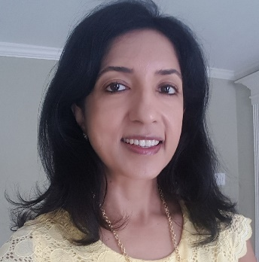
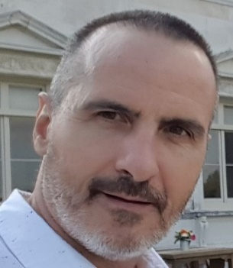
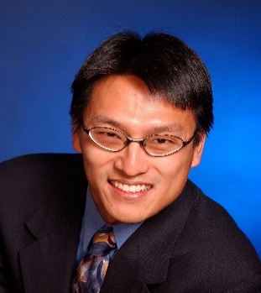
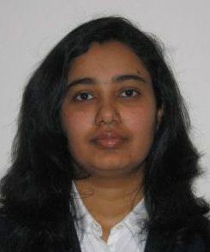

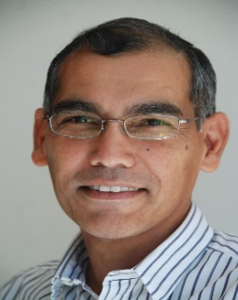
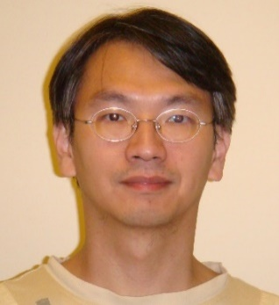

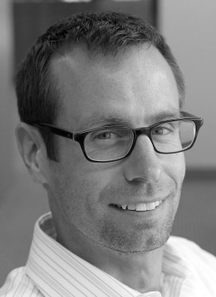
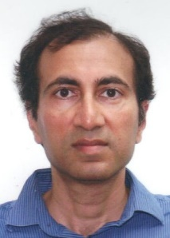
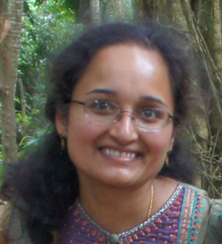
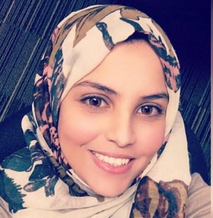
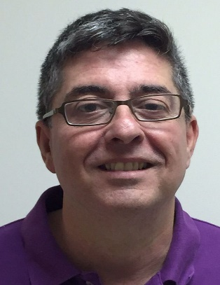
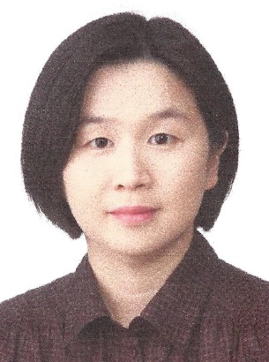


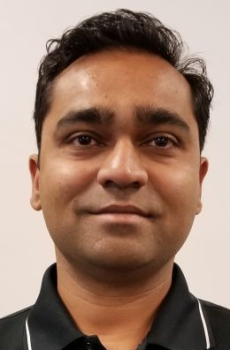
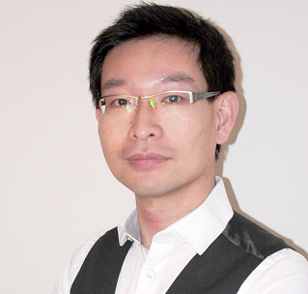
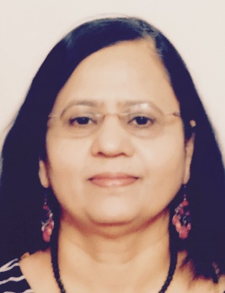
Thank You Some of those who made it all possible
Computer Vision and Pattern Recognition Laboratory

Slide 6
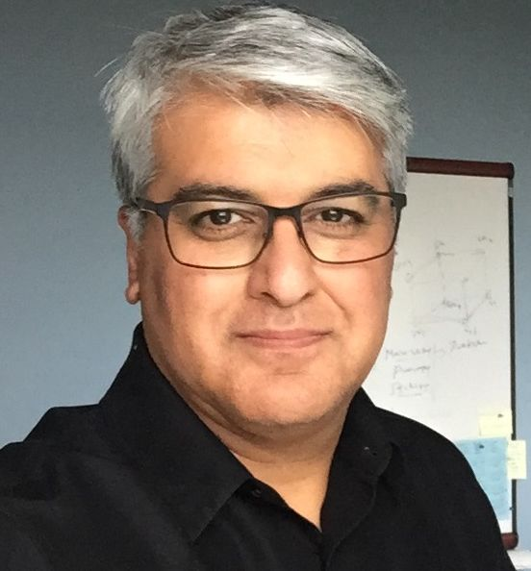
Representing them all here is Sameer Antani, Ph.D.
Sameer Antani: Video Content Characterization via Robust Recognition of Scene and Caption Text, Ph.D., 2001
Computer Vision and Pattern Recognition Laboratory

Slide 7
IAPR Leaders, Freeman, Fu, Sakai, and Pavlidis at First Meeting of the IAPR Governing Board, Kyoto, 1978
Computer Vision and Pattern Recognition Laboratory

Slide 8
What is Graphics Recognition?
A Typical Document: Three Components
Text Regions - Recognized by OCR
Images - Processed by Image Processing
Graphics- Analyzed by Graphics Recognition
Graphics include Block Diagram, Chart, Graph, Line Art, Map, Schematic, Table, etc.
Computer Vision and Pattern Recognition Laboratory
Notes:
Insert typical page image

Slide 9
Graphics Recognition: 60 Year History
Early Days (1955) to First IJCPR (1973)
First IJCPR (1973) to First GRec (1995)
First GRec (1995) to Now (2017)
IJCPR: International Joint Conference on Pattern Recognition
(Became ICPR after 1978)
GRec: IAPR Workshop on Graphics Recognition
Computer Vision and Pattern Recognition Laboratory

Slide 10
Graphics Recognition – Early Days 1955 - 1972
Computer Vision and Pattern Recognition Laboratory

Slide 11
“Pattern Recognition and Modern Computers” O. G. Selfridge, AFIPS '55 (Western) Proceedings, 1955
“Pattern Recognition… extraction of significant features
from a background of irrelevant detail”
Describes Following Problems
Two Class Problem: Large group of VERTICAL LINES on LEFT or RIGHT
Recognize Oriented Rectangles by Corner Detection
Conclusion: “simple visual patterns can be recognized by the computer, and … may improve its recognition by learning”
Computer Vision and Pattern Recognition Laboratory

Slide 12
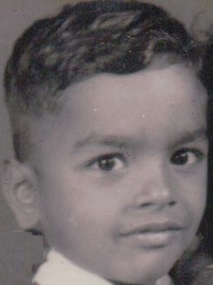
“Pattern Recognition and Modern Computers” O. G. Selfridge, AFIPS '55 (Western) Proceedings, 1955
“Pattern Recognition… extraction of significant features
from a background of irrelevant detail”
Describes Following Problems
Two Class Problem: Large group of VERTICAL LINES on LEFT or RIGHT
Recognize Oriented Rectangles by Corner Detection
Conclusion: “simple visual patterns can be recognized by the computer, and … may improve its recognition by learning”
Computer Vision and Pattern Recognition Laboratory

Slide 13
“A Computer Oriented Toward Spatial Problems”, 1958 “Pattern Detection and Recognition”, 1959 S. H. Unger, Proceedings of the IRE
Computer Vision and Pattern Recognition Laboratory

Slide 14
“Apictorial Jigsaw Puzzles…” H. Freeman and L. Garder, IEEE T. on Electronic Computers, 1964
Computer Vision and Pattern Recognition Laboratory

Slide 15
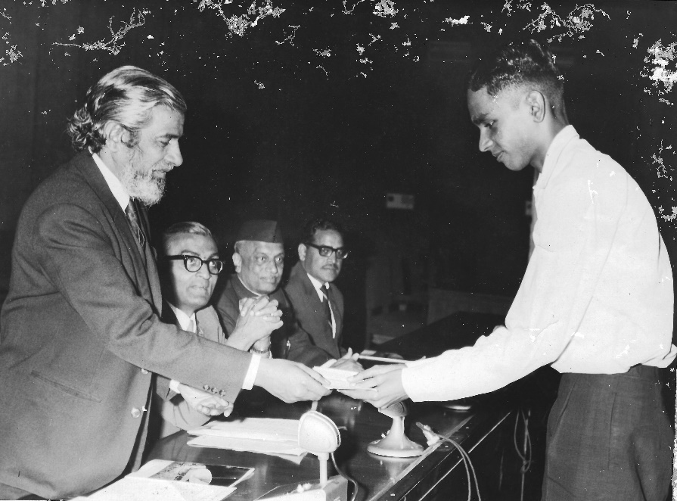
1968: Pattern Recognition journal begins publication First issue includes the paper “Distance Functions on Digital Pictures” A. Rosenfeld and J. L. Pfaltz, Pattern Recognition, Issue 1, 1968
Distances Functions Introduced
City Block
Square
Hexagonal
Octagonal
Euclidean
Just Graduated with B. Eng (Electrical)
Outstanding Student Award
Computer Vision and Pattern Recognition Laboratory

Slide 16
“Recognition of Convex Blobs” J. Sklansky, Pattern Recognition, 1970
Relationships among convex figures, concave figures, and their cellular images on a rectangular mosaic are presented
An algorithm using "minimum-perimeter polygon" is described for testing the convexity
Computer Vision and Pattern Recognition Laboratory

Slide 17
Graphics Recognition Growth to Become An Identified Scientific Discipline 1973 - 1994
Computer Vision and Pattern Recognition Laboratory

Slide 18
Graphics Recognition: 1970s
Pattern Recognition gets Established as a Scientific Discipline during 1970s
Several Books on PR are Published
I(J)CPR, PRIP (CVPR), IAPR and PAMI
All start during 1970s
Graphics Recognition Topics frequently appear in these
Computer Vision and Pattern Recognition Laboratory

Slide 19
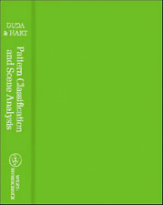
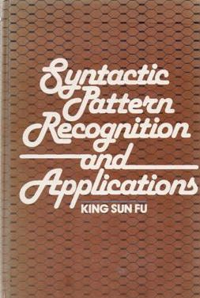
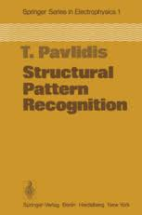
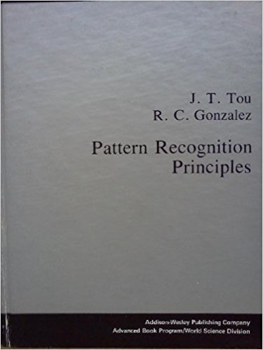
Statistical, Syntactic, and Structural Methods in Pattern Recognition
Several Books were Published during 1973-78
“Pattern Classification and Scene Analysis”
R.O. Duda and P.E. Hart, Wiley, 1973
“Pattern Recognition Principles”
J.T. Tou and R.C. Gonzalez, 1974
“Syntactic Methods in Pattern Recognition”
K.S. Fu, Academic Press, 1974
“Structural Pattern Recognition” T. Pavlidis, Springer-Verlag, 1978
Computer Vision and Pattern Recognition Laboratory

Slide 20
1973: First International Joint Conference on Pattern Recognition “Contour Detection in Noisy Pictures…” A. Martelli, 1st IJCPR, 1973
Original Noisy Boundary
Computer Vision and Pattern Recognition Laboratory

Slide 21
“Computer Processing of Line-Drawing Images” H. Freeman, Computing Surveys, 1974
Computer Vision and Pattern Recognition Laboratory

Slide 22
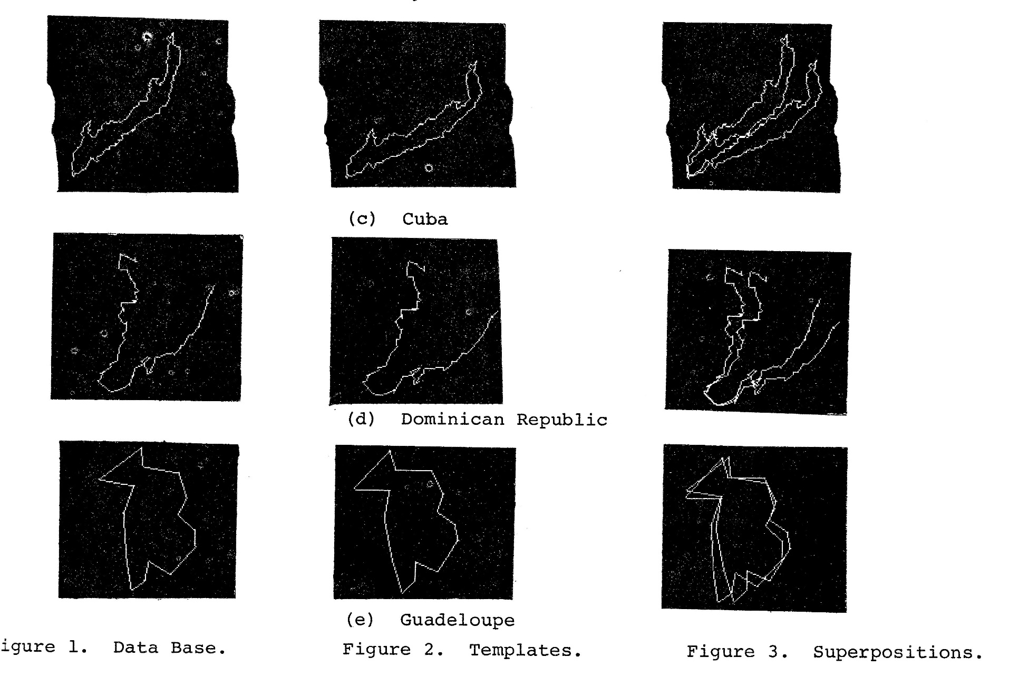
IEEE Pattern Recognition and Image Processing PRIP Series Begins in 1977 (Changes to CVPR in 1983)
“Shape Matching using Relaxation Techniques”
L.S. Davis, PRIP, 1977
Computer Vision and Pattern Recognition Laboratory

Slide 23
“Map Data Processing: Proceedings of NATO Workshop” Edited by H. Freeman and Pieroni, 1979
Computer Vision and Pattern Recognition Laboratory

Slide 24
IEEE T. PAMI First Paper Published in January 1979
Computer Vision and Pattern Recognition Laboratory

Slide 25
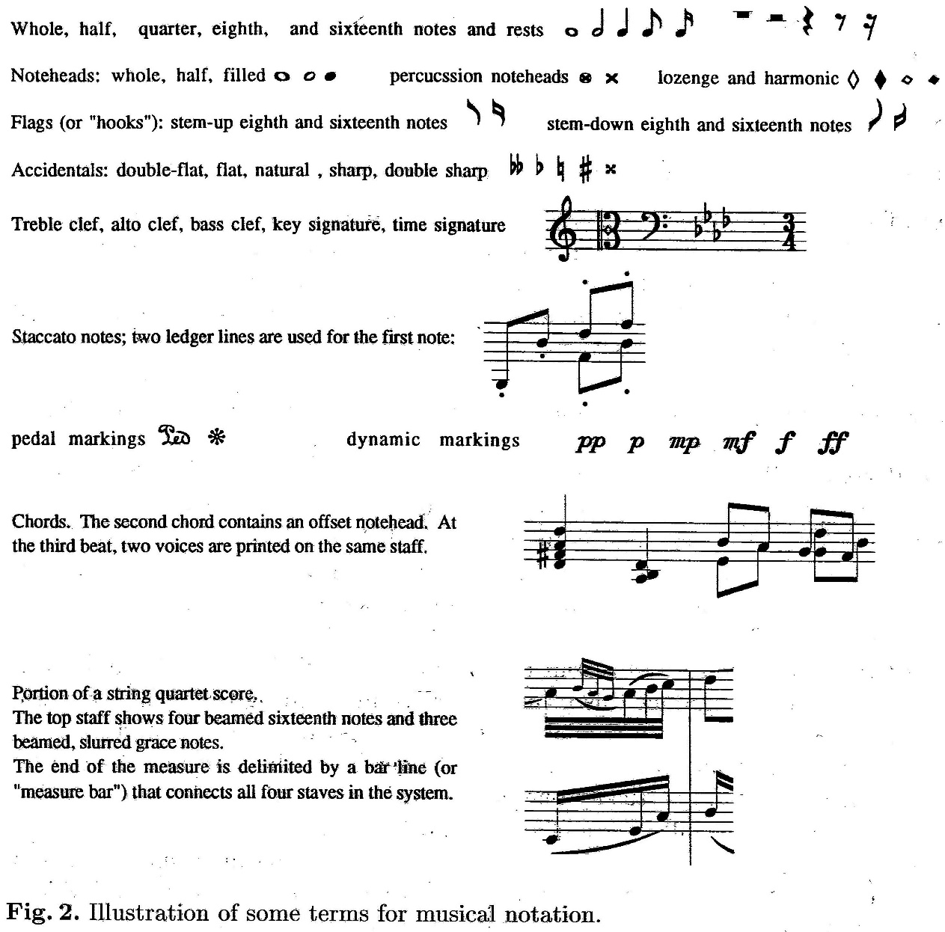
Early work in Music Recognition “A Critical Survey of Music Image Analysis” D. Blostein and H.S.Baird, Structured Document Image Analysis, Springer ,1992
A Comprehensive Survey of some 50 papers on Music Recognition including
Recognition of Music Symbols
Staff Lines
Symbol Classification
Relative Positions of Symbols
Syntactic Methods (for analysis)
Dance Notation
Computer Vision and Pattern Recognition Laboratory

Slide 26
“A Width Independent Fast Thinning Algorithm” C. Arcelli and G. Sanniti di Baja, IEEE T. PAMI, 1985
Computer Vision and Pattern Recognition Laboratory

Slide 27
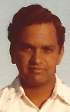
IAPR S+SSPR Workshops
Workshop series on
Syntactic and Structural Methods in Pattern Recognition
First event organized in 1981 by
K.S. Fu, T. Pavlidis, J.L. Mundy and J.K. Aggarwal
This complemented the Workshop series on
Statistical Methods In Pattern Recognition
These are often held in the same location
(S+SSPR 2016 held in Mérida, Mexico)
-----------------------------------------
Kasturi-1981
Graduate Student at Texas Tech University
Topic: Image Restoration in Signal Dependent Noise
Computer Vision and Pattern Recognition Laboratory

Slide 28
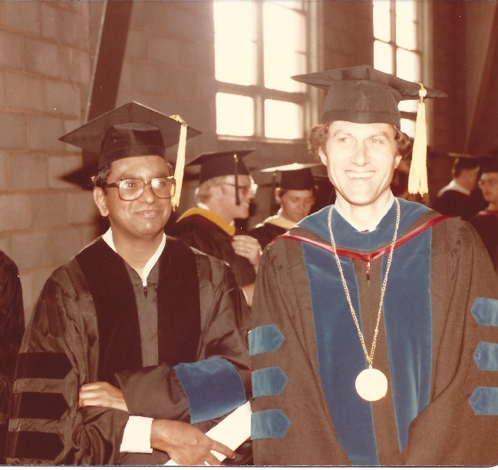
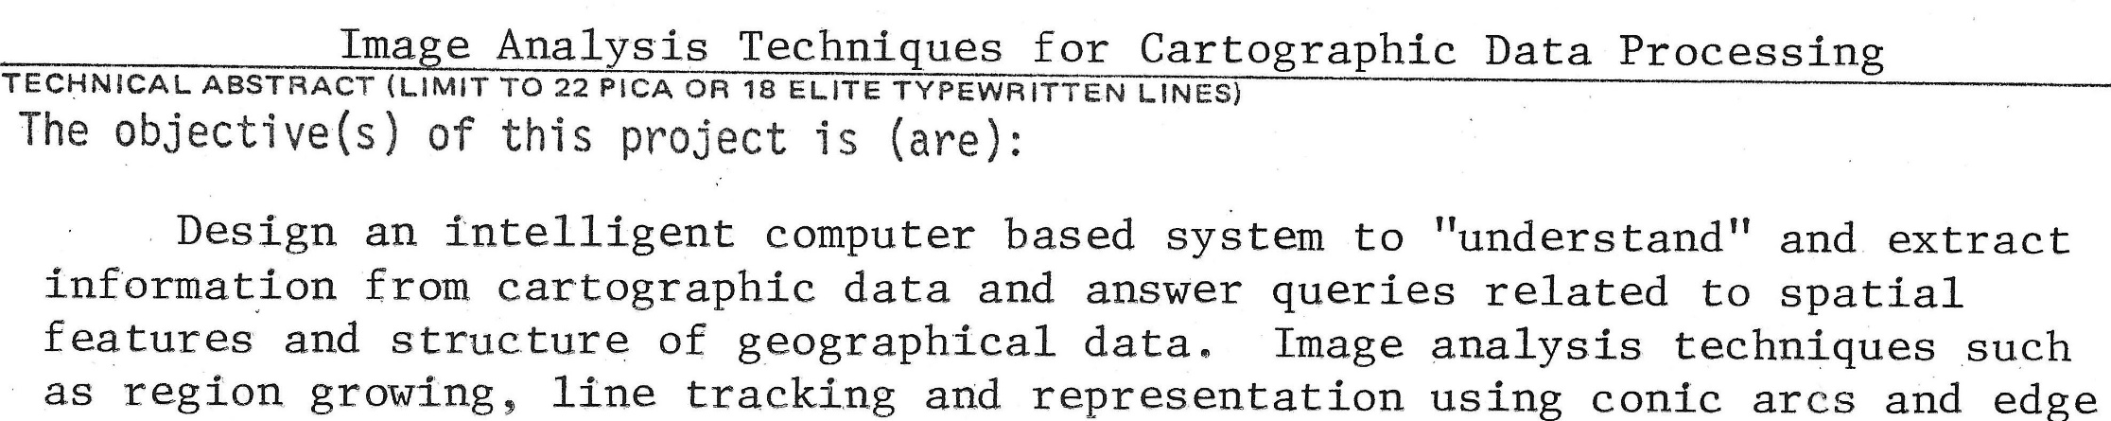
1982: With John F. Walkup, Advisor
Joined the Pennsylvania State University
Had to find a new topic for my research
Always interested in MAPS
Proposal submitted in January 1983; Grant for $48,000 Received from National Science Foundation in April 1983
Finally, started working in Graphics Recognition!
Computer Vision and Pattern Recognition Laboratory

Slide 29
Some Results from Map Analysis project (1983-87) O. Morean and R. Kasturi, My First ICPR, Montreal, 1984 R. Kasturi and J. Alemany, IEEE TSE, 1988
Simplified Map of Western USA
Show “Roads” Within “State” Containing “Lubbock”
Developed Algorithms for
Text-Graphics Separation
Symbol Recognition
Dashed Line Detection
Query Processing
Shortest Distance
R. Fernandez. who worked on this project, was hired to lead the Yahoo Maps project.
Map after Text String Separation
Computer Vision and Pattern Recognition Laboratory

Slide 30
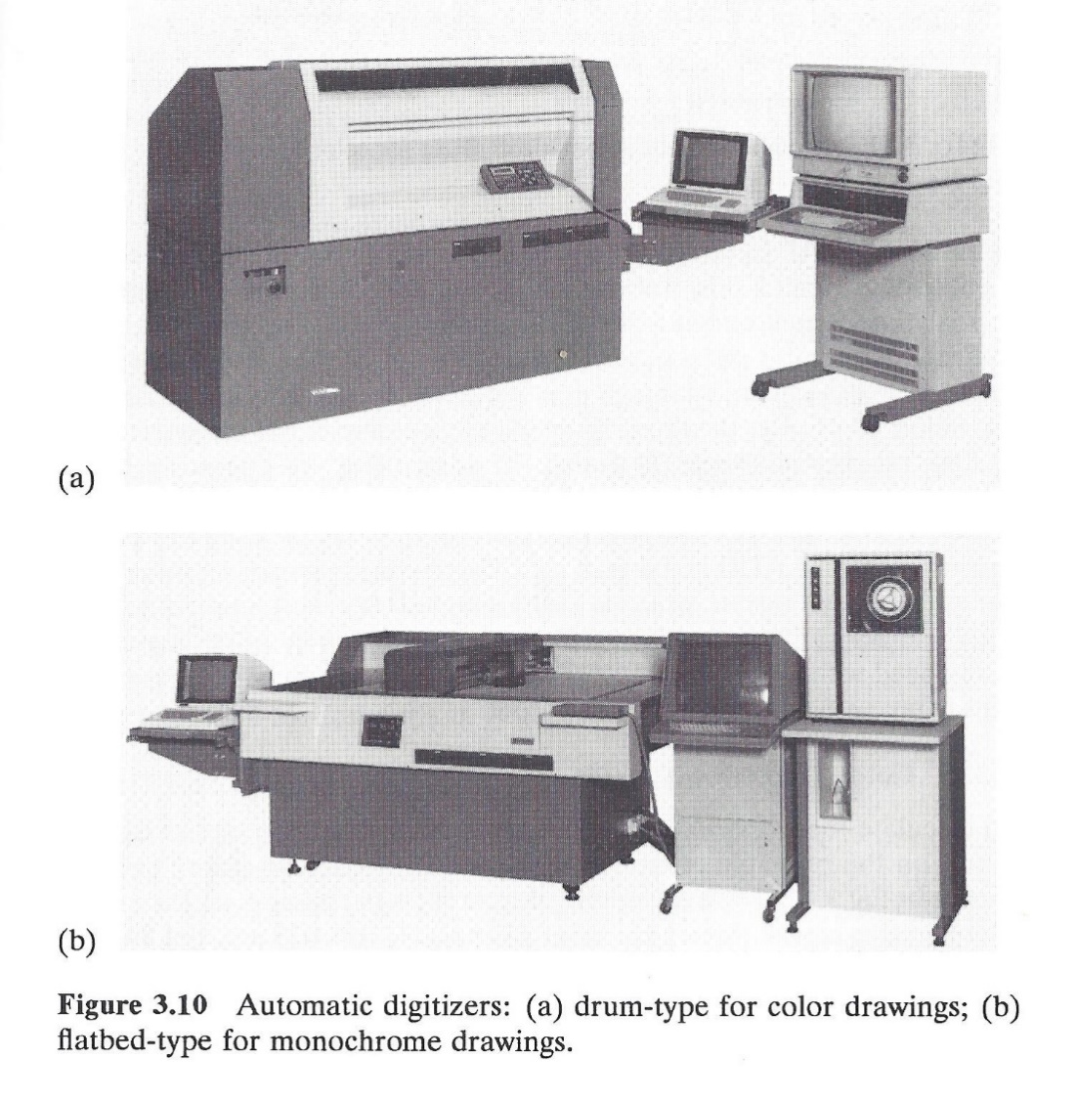
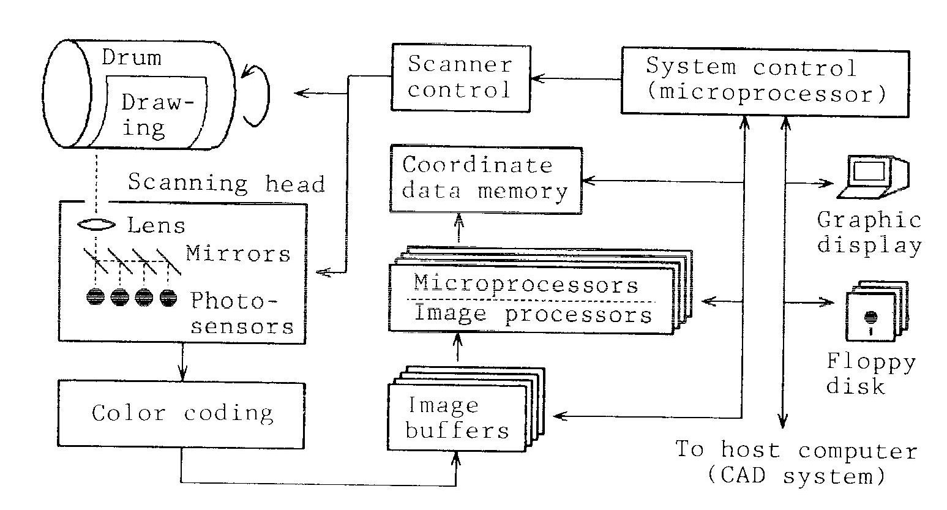
“Development of Auto-Digitizer…” S. Kakumoto, T. Miyatake, S. Shimada, and M. Ejiri, CVPR 1983
Hitachi Central Research Laboratory, Japan
Computer Vision and Pattern Recognition Laboratory

Slide 31
IAPR Workshop on Machine Vision Applications, Tokyo,1990 Organized by Masakazu Ejiri
Map and Line Drawing Processing
Raster-to Vector Conversion
Interpretation of Road Maps
Shorthand Recognition
Jigsaw Puzzle Assembly
Traffic Sign Detection
Structured Document Recognition
Layout Structure Analysis
Page Reader
Fingerprint Classification
Computer Vision and Pattern Recognition Laboratory

Slide 32
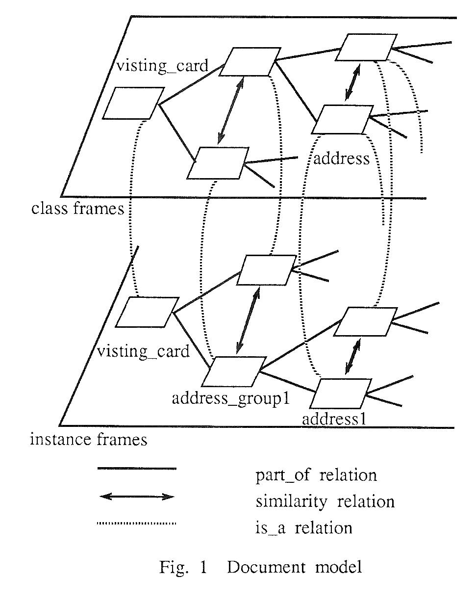
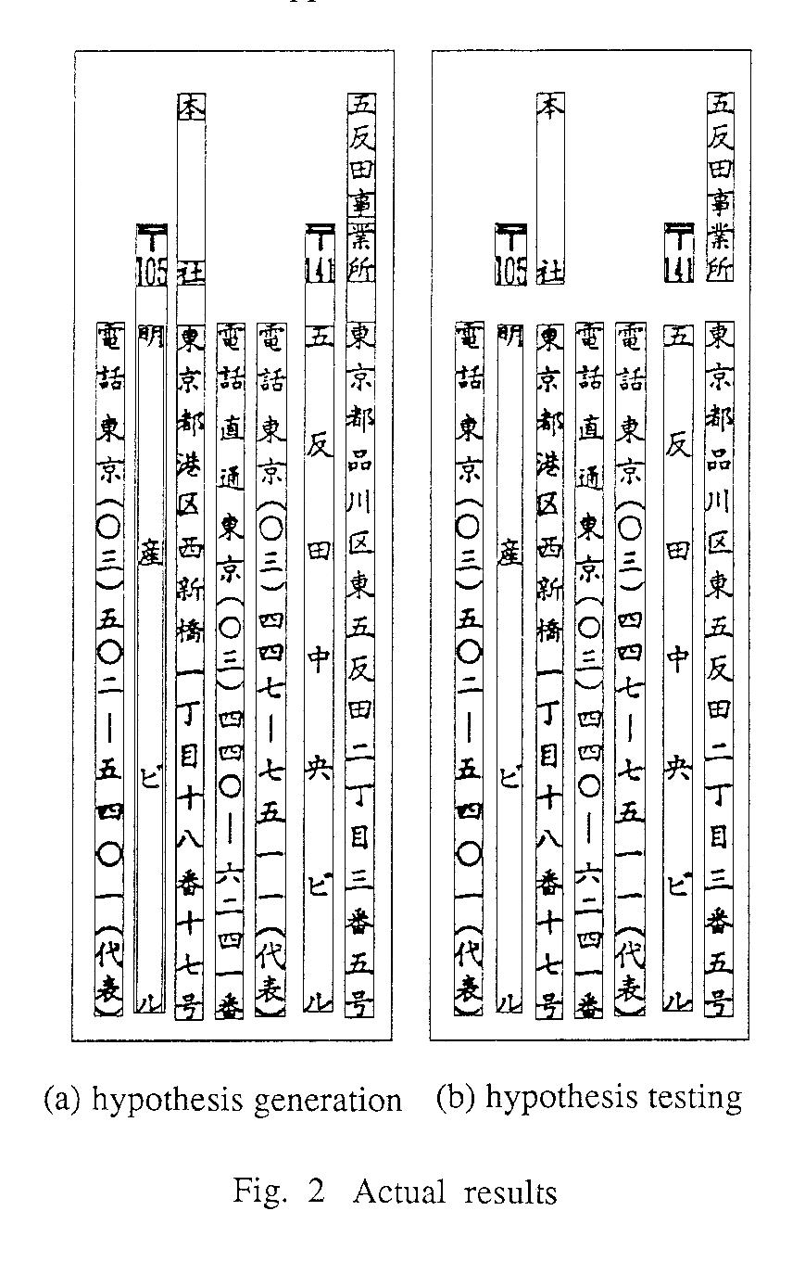
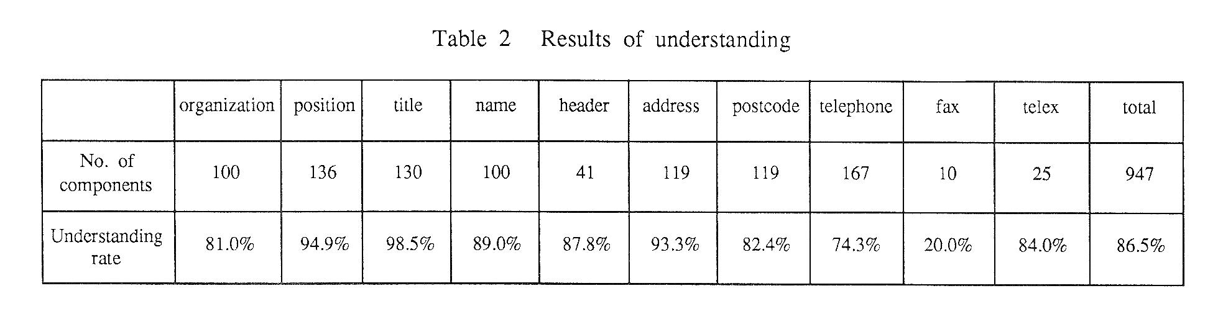
“Model based Understanding of Document Images” K. Kise, et al., IAPR MVA Workshop, 1990
Computer Vision and Pattern Recognition Laboratory

Slide 33
“Automatic Digitizing of the Colour-Layer of Thematic Maps” R. Espelid, et al., IAPR MVA Workshop, 1990
Computer Vision and Pattern Recognition Laboratory

Slide 34
IAPR TC10 From Map and Line Drawing Processing to Graphics Recognition
TC10 on Map and Line Drawing Processing
Established during early years of IAPR
I was appointed as its Chair by President Martin Levine in 1988
First Experience in Leadership Activities
Renamed as TC10 on Graphics Recognition in 1992 to broaden its appeal
Provided a home for researchers with interest in Graphics Recognition to exchange their experiences
Graphics Recognition became an Identified Scientific Topic
Computer Vision and Pattern Recognition Laboratory

Slide 35
General Purpose Graphics Recognition Project (1986-90) Test Image (1990 PAMI)
Computer Vision and Pattern Recognition Laboratory

Slide 36
General Purpose Graphics Recognition Project After Text Separation
Computer Vision and Pattern Recognition Laboratory

Slide 37
General Purpose Graphics Recognition Project Dashed Line Detection Algorithm
Computer Vision and Pattern Recognition Laboratory

Slide 38
General Purpose Graphics Recognition Project Recognition of Shapes and their Attributes
Computer Vision and Pattern Recognition Laboratory

Slide 39
Processing Graphics Containing Circular Arc Segments
Computer Vision and Pattern Recognition Laboratory

Slide 40
Interpretation of 3-D from Orthographic Projections P.M. Devaux, D.B. Lysak, and R. Kasturi., ICPR 1990, IJDAR 1999
Computer Vision and Pattern Recognition Laboratory

Slide 41
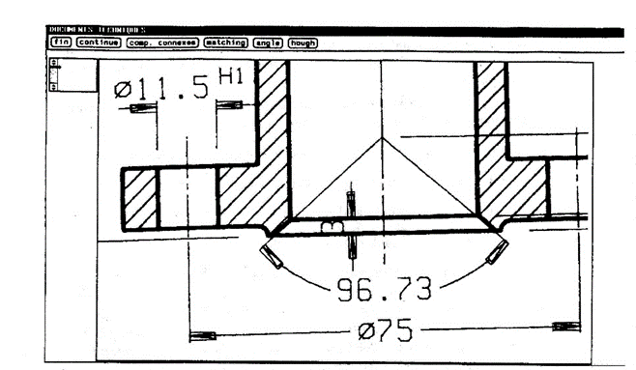
“Engineering Drawing Conversion: Arrow Detection” Antoine, Collin, and Tombre, SSPR 1990
Computer Vision and Pattern Recognition Laboratory

Slide 42
“Interpretation of Telephone System Manhole Drawings” Arias, Lai, Surya, Kasturi, and Chhabra, PRL, 1994
Original Drawing
Extracted Manhole
Cable Connections
Summary Table
Computer Vision and Pattern Recognition Laboratory

Slide 43
“Automatic Digitization of Large Scale Maps” Andreas Illert, ACSM-ASPRS, Vol. 6, pp. 113-122,1991
Computer Vision and Pattern Recognition Laboratory

Slide 44
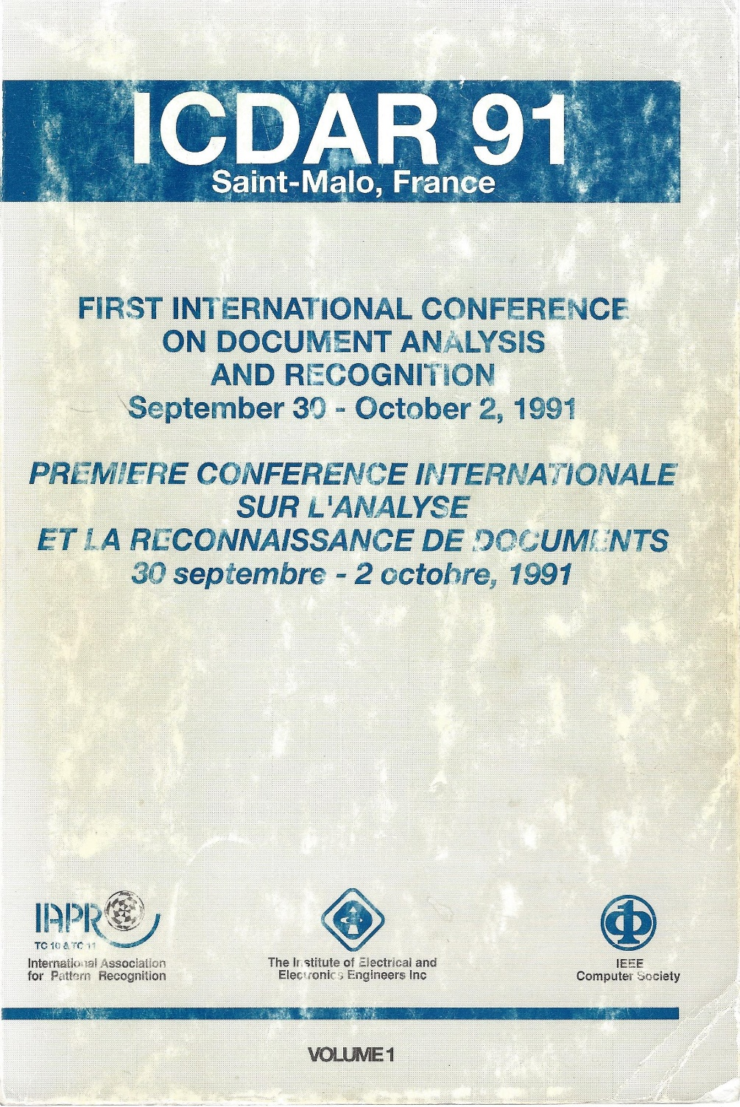
ICDAR Series Began in 1991
Conference Chairs
Guy Lorrette
Ching Suen
Program Chairs
Robert Haralick
Sargur Srihari
Georges Stamon
Sponsored by
TC10 (R. Kasturi, Chair)
TC11 (R. Plamondon, Chair)
100+ Papers from 200+ Authors
1000 Page Proceedings
14 Sessions
Computer Vision and Pattern Recognition Laboratory

Slide 45
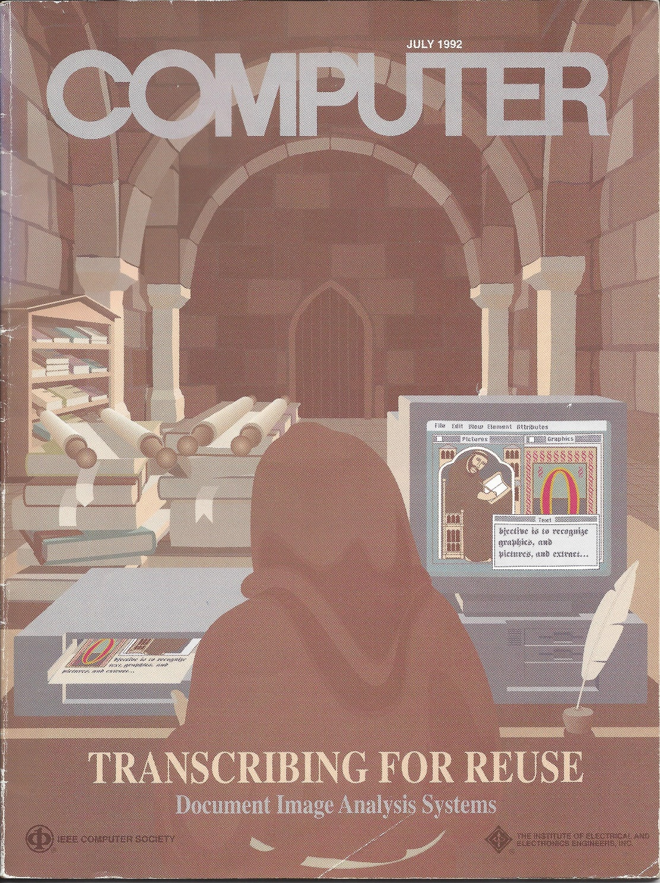
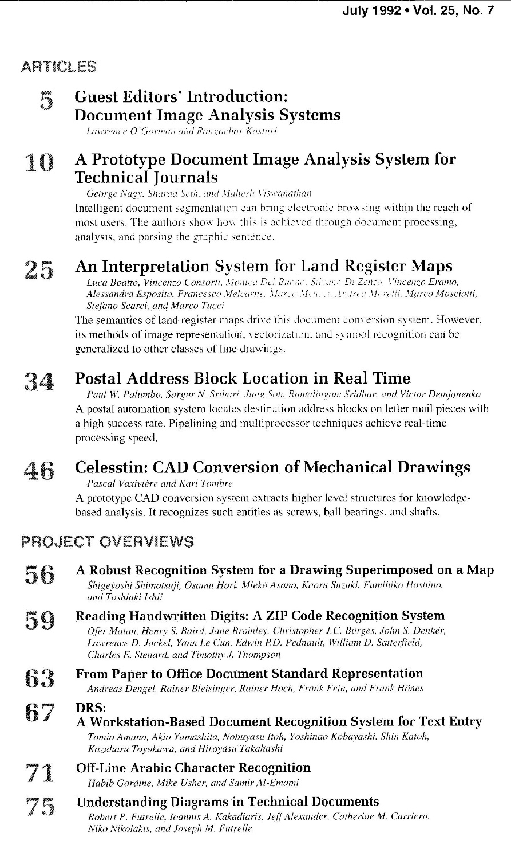
Special Issue of IEEE Computer 1992 L.O’Gorman and R. Kasturi, Editors
Computer Vision and Pattern Recognition Laboratory

Slide 46
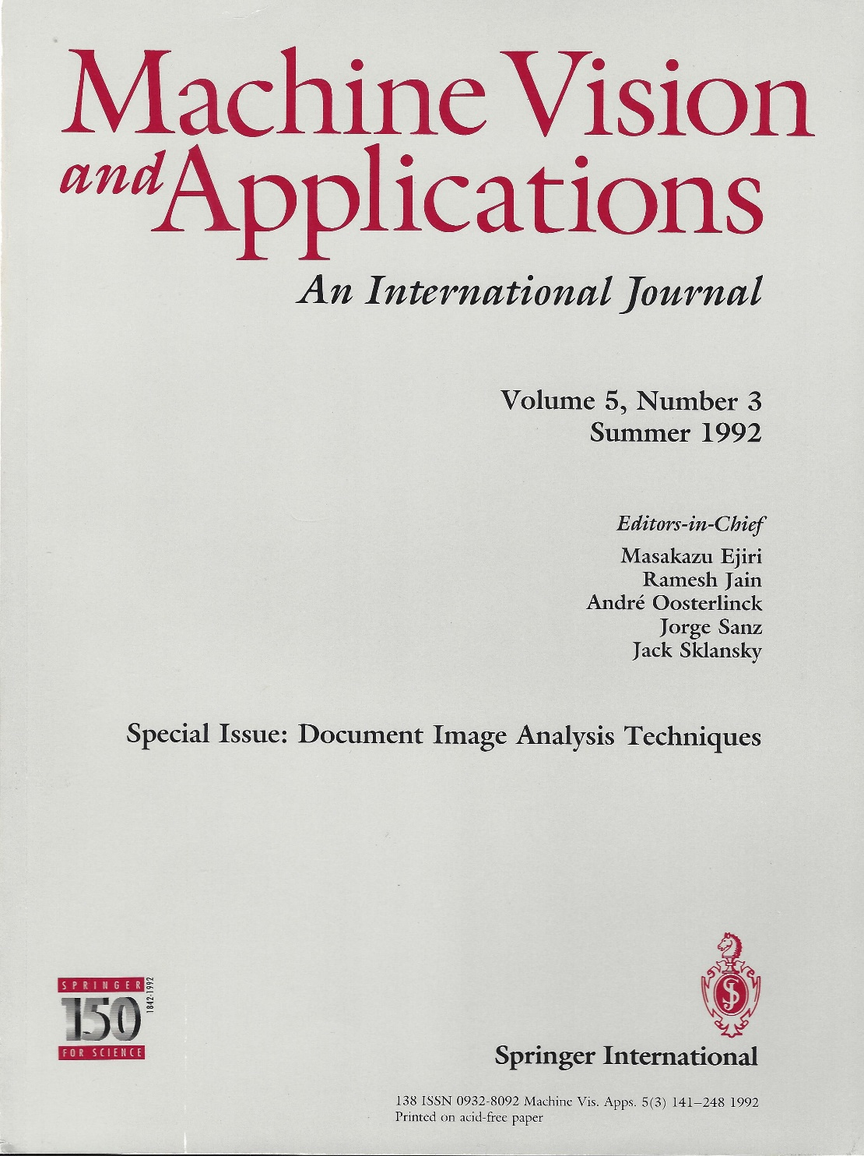
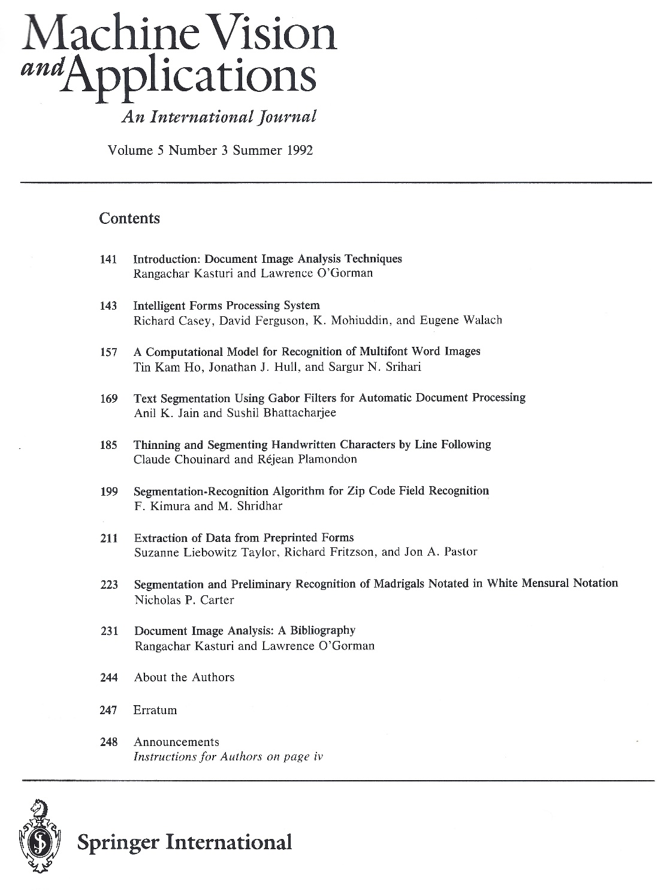
Special Issues of MVA Journal, 1992, 1993 R. Kasturi and L.O’Gorman, Editors
Computer Vision and Pattern Recognition Laboratory

Slide 47

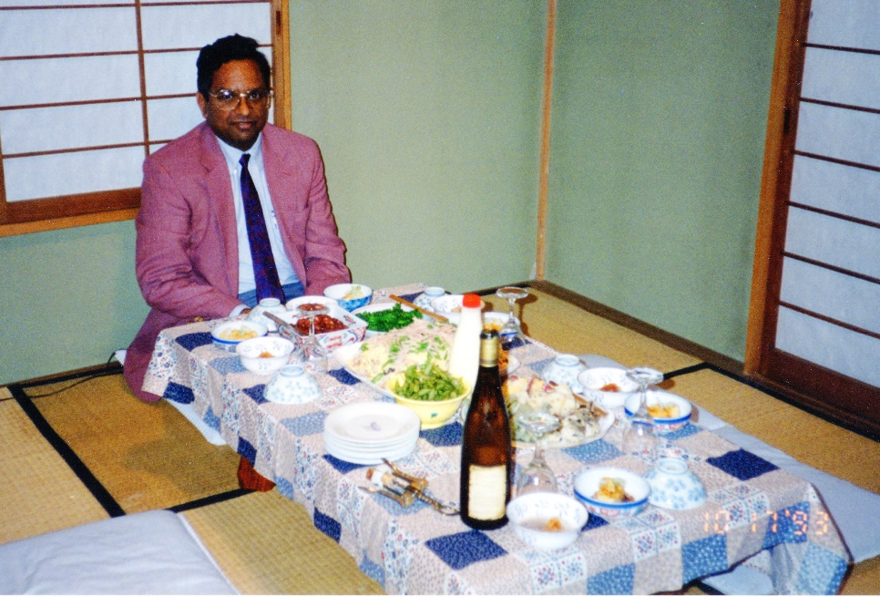
Organized by Kazuhiko Yamamoto
Computer Vision and Pattern Recognition Laboratory

Slide 48
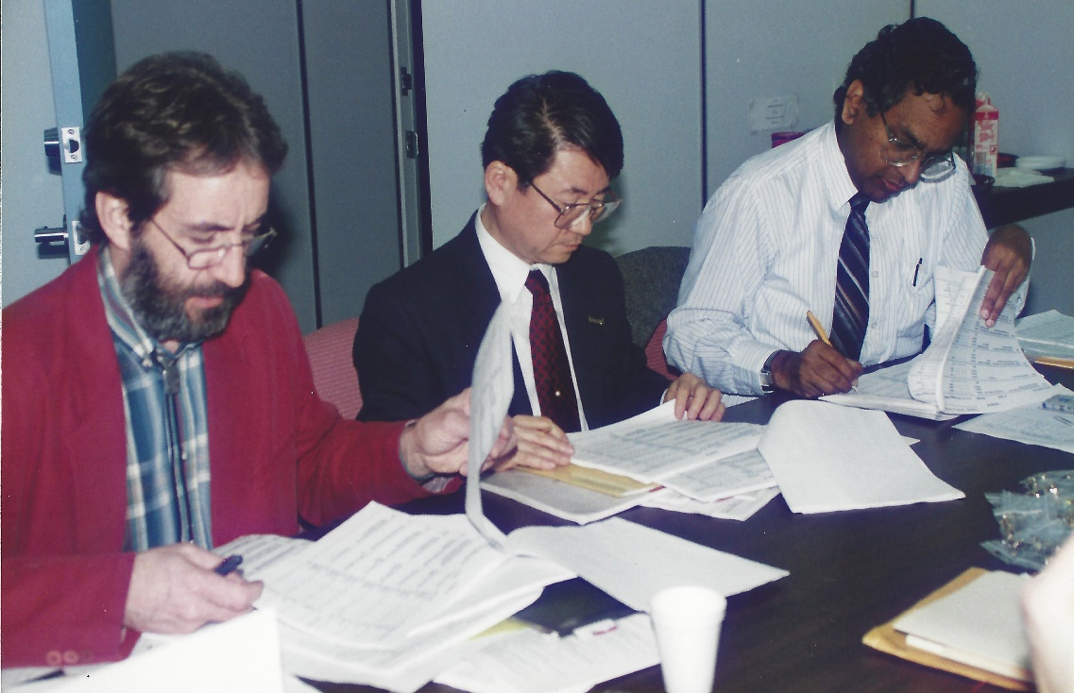
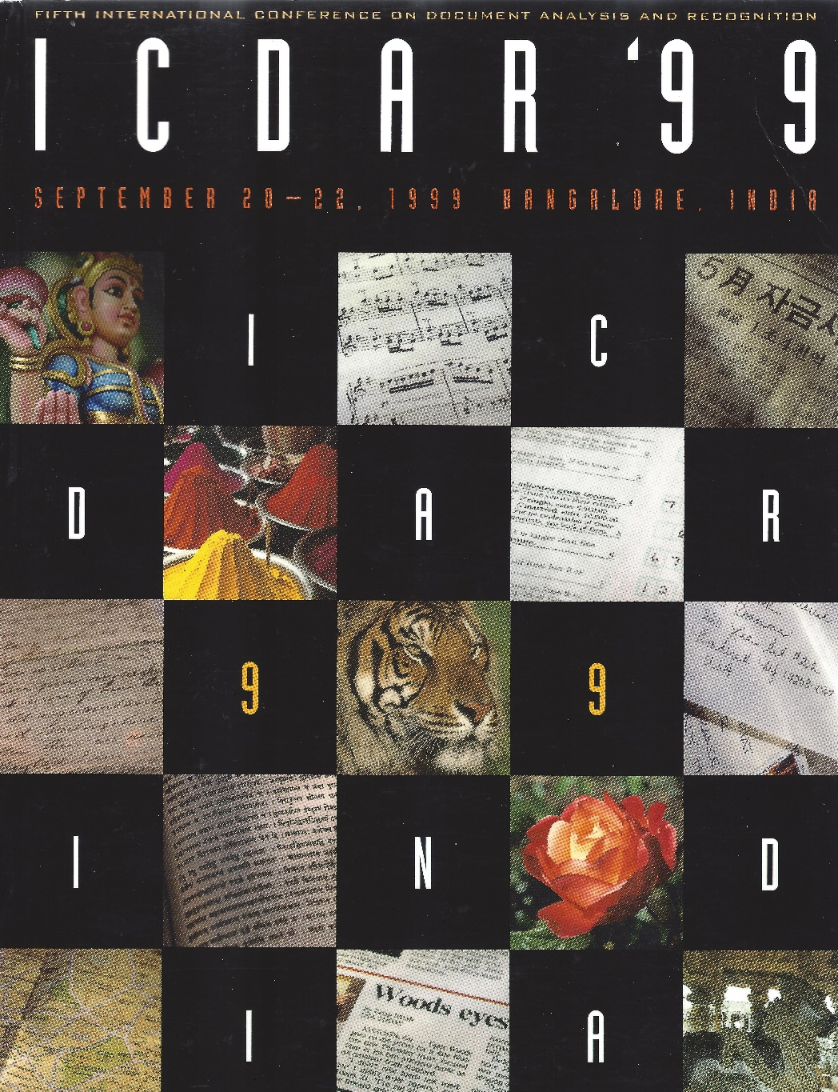
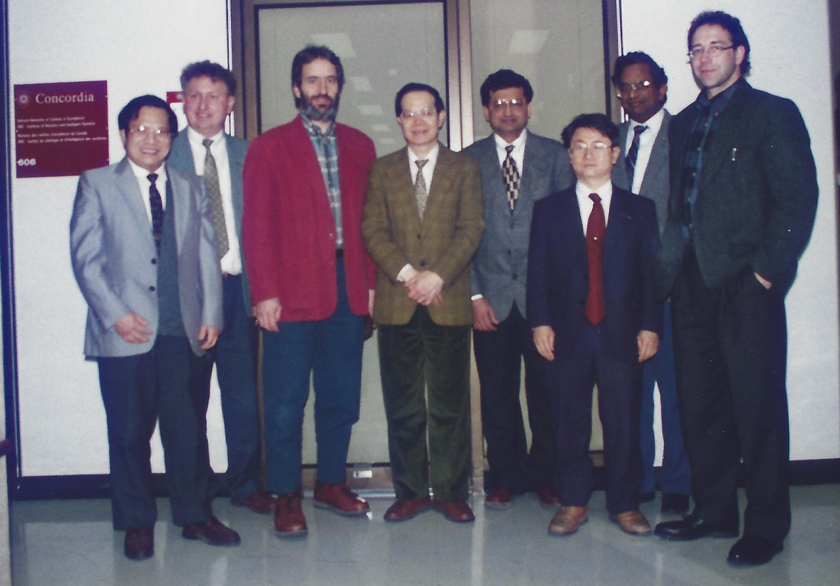
Next Three: Montreal,1995; Ulm 1997; and Bangalore,1999
S.N. Srihari and R. Kasturi (General Chairs)
Computer Vision and Pattern Recognition Laboratory

Slide 49
Graphics Recognition – Recent Progress 1995 - Present
Computer Vision and Pattern Recognition Laboratory

Slide 50
First International Workshop on Graphics Recognition August 9-11, 1995 Pennsylvania USA
Session Topics
Basic Techniques and Symbol-level Recognition
Map Processing
Engineering Drawings
Applications of Graphics Recognition
Performance Evaluation
Dashed Line Detection Contest
Computer Vision and Pattern Recognition Laboratory

Slide 51
GRec Contests
1995: Dashed Line Detection
1997: Raster to Vector Conversion
2001: Arc Segmentation
2003: Symbol Recognition
2005: Symbol Recognition II
2007: Symbol Recognition III
2009: Arc Segmentation II
2011: Isolated Symbol Recognition and Symbol Spotting
2013: Music Scores Competition: Staff Removal
2013: Arc and Line Segmentation
2015: Engineering Drawing Challenge I
2017: Engineering Drawing Challenge II
Computer Vision and Pattern Recognition Laboratory

Slide 52
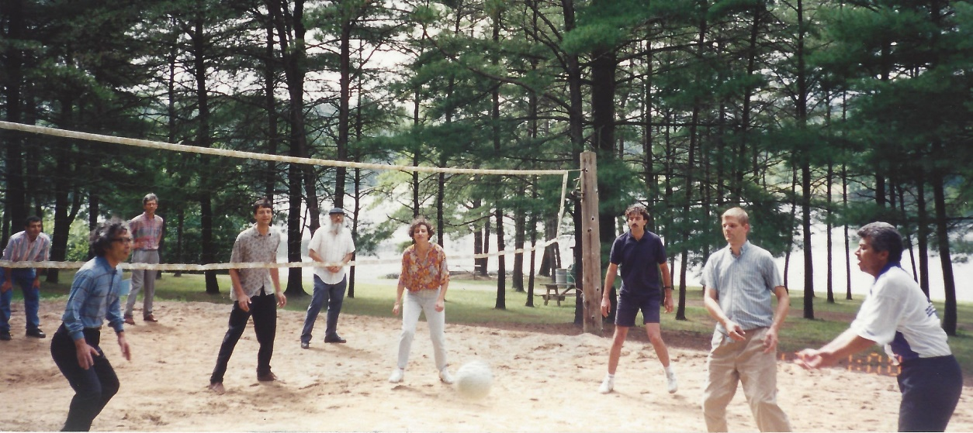
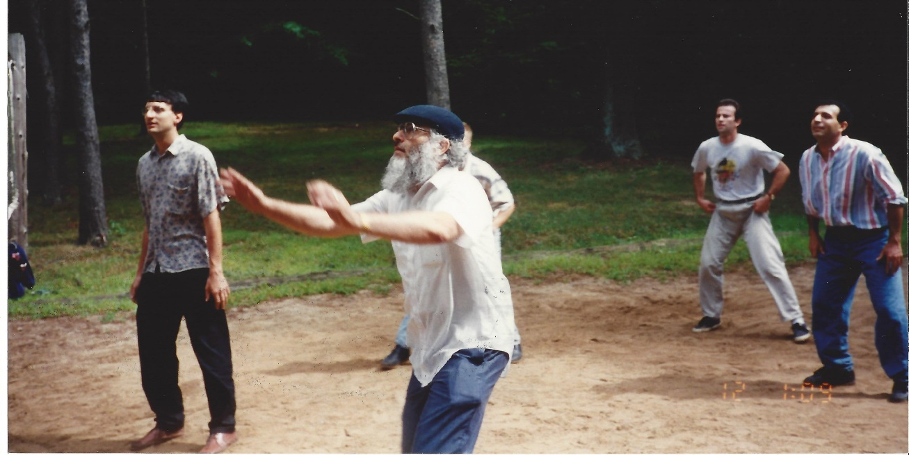
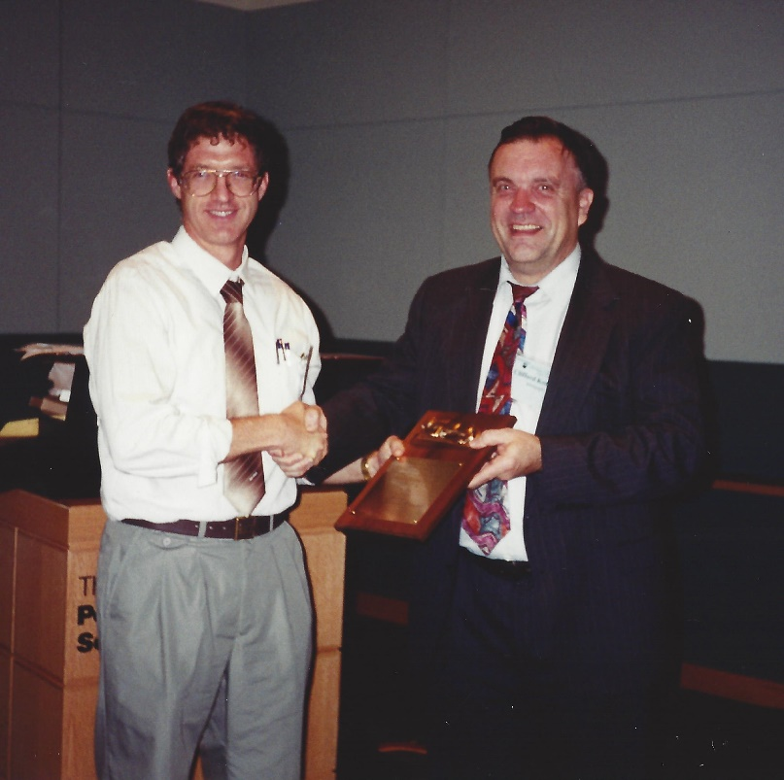
GRec 1995
State College Pennsylvania
Dov Dori receiving Dashed Line Detection Award
(Winning Team: D. Dori, L. Wenyin and M. Peleg)
Computer Vision and Pattern Recognition Laboratory

Slide 53

Document Image Analysis Tutorial Text
Computer Vision and Pattern Recognition Laboratory

Slide 54

Document Analysis Systems Workshops Begin in 1994
Computer Vision and Pattern Recognition Laboratory

Slide 55

International Journal on Document Analysis and Recognition
Begins Publication in 1998
Current Editors-in-Chief: K. Kise; D. Lopresti; S. Marinai
Foundaing Managing Editor: David Doermann
Computer Vision and Pattern Recognition Laboratory

Slide 56

New Workshop on Camera-Based Document Analysis and Recognition since 2005
Computer Vision and Pattern Recognition Laboratory

Slide 57
Text Detection in Video/Images: An Example J. Zhang and R. Kasturi, CBDAR 2013 and IEEE TIP 2014
Results on 2003-05 ICDAR Dataset
Computer Vision and Pattern Recognition Laboratory

Slide 58
Grec 1995 to 2017
GREC 2017, Kyoto
27 papers organized into 6 sessions
Interpretation of engineering drawings, maps, charts, etc.
Symbol Recognition and Spotting
Optical Music Recognition
Interpretation of drawings, music scores, tables, etc.
Raster to Vector and drawings
Performance Evaluation and Interpretation
Engineering Drawing Challenge II
GREC 1995, State College, Pennsylvania
Basic Techniques and Symbol-level Recognition
Map Processing
Engineering Drawings
Applications of Graphics Recognition
Performance Evaluation
Computer Vision and Pattern Recognition Laboratory

Slide 59
Graphics Recognition Today
Some 250 papers on GR Topics since 2007
Fewer papers in Raster to Vector Conversion, Map Analysis, Tables, etc.
Continuing interest in Music Recognition and Historical Document Analysis
Increased interest in analyzing natural Video/Image data captured by cameras
Much Interest: Sketch or Example-driven Recognition (SIGGRAPH/EuroGraphics, Multimedia and CBIR Communities are Ahead of us).
Thanks to Jing Zhang for Data Compilation and Analysis
Computer Vision and Pattern Recognition Laboratory

Slide 60

Historical Documents: An Example From U.S. National Archives
Computer Vision and Pattern Recognition Laboratory

Slide 61

Historical Documents: One Example
Computer Vision and Pattern Recognition Laboratory

Slide 62

Text from Microfilm Images of Punched Cards An Example of Historical Document Processing S.Kumar and R. Kasturi, ICPR 1992
Computer Vision and Pattern Recognition Laboratory

Slide 63
Processing Steps
Skew Correction
Morphological Processing
Final Image
Decoded Text
Computer Vision and Pattern Recognition Laboratory

Slide 64
One Final Thought: Do we need an Open GR?
We have seen the impact of Open CV in accelerating Computer Vision research.
But most Graphics Recognition applications appears to be still built from scratch.
Should we invest in developing an Open GR?
Perhaps contribute to adding Graphics Recognition tools to Open CV?
Build upon Other Initiatives such as Aletheia?
Computer Vision and Pattern Recognition Laboratory

Slide 65
Thank You Research Sponsors
U.S. Federal Government
National Science Foundation
National Security Agency
NASA
Department of Defense
Defense Advanced Research Projects Agency
Intelligence Advanced Research Projects Agency
Corporations
AT&T, Bizlink, BP, Digital, IBM, NYNEX
Kodak, Raytheon, STS, Xerox
AND
U.S. States of Florida and Pennsylvania
Computer Vision and Pattern Recognition Laboratory

Slide 66
Thank You Research Collaborators
Terri Ashmeade
Sing-Tze Bow
Octavia Camps
Dmitry Goldgof
Lawrence Hall
Ramesh Jain
Soundar Kumara
Ravi Sankar
Sudeep Sarkar
Rajeev Sharma
Leon Sibul
Yu Sun
Computer Vision and Pattern Recognition Laboratory

Slide 67
Questions?
Computer Vision and Pattern Recognition Laboratory

Slide 68

Thank You You made it all possible
W. El-Masri: Recognition and Description of Graphical Primitives, MSEE, 1988
Computer Vision and Pattern Recognition Laboratory

Slide 69

Thank You You made it all possible
J. Min: Human Activity Recognition Using Motion Trajectories, Ph.D., 2005
Computer Vision and Pattern Recognition Laboratory

Slide 70
Thank You You made it all possible
D. Crandall: Detection of Stylized Text in Video, M.S. CSE and BS (Honors), May 2001
Computer Vision and Pattern Recognition Laboratory

Slide 71

Thank You You made it all possible
Y.L.Tang: An Airborne System for Runway Recognition and Obstacle Detection, Ph.D., August 1994
Computer Vision and Pattern Recognition Laboratory

Slide 72
Thank You You made it all possible
H. Vajaria: Localization and Identification of Participants in Meeting Archives, Ph.D., 2008
Computer Vision and Pattern Recognition Laboratory

Slide 73
Thank You You made it all possible
J. Zhang: Extraction of Text Objects in Image and Video Documents, Ph.D. 2012
Computer Vision and Pattern Recognition Laboratory

Slide 74
Thank You You made it all possible
H. Halliyal: Speech Recognition System for Kannada Language, MSEE, 1987
Computer Vision and Pattern Recognition Laboratory

Slide 75

Thank You You made it all possible
M. Yang: An Automatic Scheduler for Real-time Vision Applications, Ph.D., Dec. 2000
Computer Vision and Pattern Recognition Laboratory

Slide 76
Thank You You made it all possible
U.B. Mokate: An Algorithm for Recognition of Circles in Graphics, MSEE, 1988
Computer Vision and Pattern Recognition Laboratory

Slide 77

Thank You You made it all possible
P. Devaux: Experimental Verification of Automated Interpretation of Engineering Drawings, MSEE, May 1995
Computer Vision and Pattern Recognition Laboratory

Slide 78
Thank You You made it all possible
D.B. Lysak: Interpretation of Engineering Drawings of Polyhedral and Non-polyhedral Objects, Ph.D., 1991
Computer Vision and Pattern Recognition Laboratory

Slide 79

Thank You You made it all possible
S. Antani: Video Content Characterization via Robust Recognition of Scene and Caption Text, Ph.D., 2001
Computer Vision and Pattern Recognition Laboratory

Slide 80
Thank You You made it all possible
S.Chandran: Structural Recognition of Tabulated Data, MSCmpE, 1993
Computer Vision and Pattern Recognition Laboratory

Slide 81
Thank You You made it all possible
G. Zamzmi: Infant Pain Analysis, Ph.D. 2018
Ph.D. Candidate
Computer Vision and Pattern Recognition Laboratory

Slide 82
Thank You You made it all possible
H.T. Liang: Automatic Searching of Shortest Path in Maps, 1988
Computer Vision and Pattern Recognition Laboratory

Slide 83

Thank You You made it all possible
A. Prasad: System for Intelligent Interpretaion of Text from Telephone Company Drawings, MSCmpE, August 1995
Computer Vision and Pattern Recognition Laboratory

Slide 84

Thank You You made it all possible
J. Arias: Efficient Techniques for Line Drawing Interpretation, PhD, August 1995
Computer Vision and Pattern Recognition Laboratory

Slide 85

Thank You You made it all possible
W.C. Feng: A Learn-By-Example Natural Language Processor, MSCmpE, 1990.
Computer Vision and Pattern Recognition Laboratory

Slide 86
Thank You You made it all possible
N. Muralidhar: Collection of Training Data for OCR of Kannada Characters, 1999
Computer Vision and Pattern Recognition Laboratory

Slide 87
Thank You You made it all possible
S. Hinduja: Pedestrian Detection in Low Quality Moving Camera Videos, MS, 2016,
Computer Vision and Pattern Recognition Laboratory

Slide 88

Thank You You made it all possible
R.J. Fernandez: Extraction of Feature Overlays for Query Processing in a Geographic Information System, MSEE, 1989.
Computer Vision and Pattern Recognition Laboratory

Slide 89
Thank You You made it all possible
U. Gargi: Visual Content Characterization of Images and Video, Ph.D., Dec. 1999
Computer Vision and Pattern Recognition Laboratory

Slide 90
Thank You You made it all possible
P.K. Mohanty: Learning from Biometric Distances Performance and Security Related issues in Face Recognition, Ph.D., 2007
Computer Vision and Pattern Recognition Laboratory

Slide 91
Thank You You made it all possible
J.H. Park: Manifold Learning in Computer Vision, Ph.D., 2005
Computer Vision and Pattern Recognition Laboratory

Slide 92
Thank You You made it all possible
J. Candamo: Boundary Profile Representation for Objects and Their Surroundings in Outdoor Videos, Ph.D. 2009
Computer Vision and Pattern Recognition Laboratory

Slide 93
Thank You You made it all possible
M. Fathollahi: Estimation of human pose categories, Ph.D. 2017
Computer Vision and Pattern Recognition Laboratory

Slide 94
Thank You You made it all possible
J. Viswanathan, Continuous Identity Assurance, MS, 2016
Computer Vision and Pattern Recognition Laboratory

Slide 95
Thank You You made it all possible
T. Gandhi: Image Sequence Analysis for Object Detection and Segmentation, Ph.D., May 2000
Computer Vision and Pattern Recognition Laboratory

Slide 96

Thank You You made it all possible
L.A. Fletcher: Automated Text String Separation from Mixed Text/Graphics Images, MSEE, 1986
Computer Vision and Pattern Recognition Laboratory

Slide 97
Thank You Those Not Pictured
A. Modi, Pedestrian detection at traffic intersections , MS, 2017
V. Kamath, Survival prediction for colon cancer patients, M.S., 2005
V. Mariano, Video Object Detection and Matching, Ph.D., 2003
P.Tofani, Segmentation of Text from Color Map Images, MS, 1998
S.Devadiga, Detection of Obstacles in Monocular Image Sequences, Ph.D., 1997
S.Natarajan, A Hierarchical Scheme for Invoice Classification, MS, 1997
S.Balasubramanian, Information Extraction From Tabular Drawings, MSEE, May 1994
C.P.Lai, Knowledge-based Understanding of Engineering Drawings, Ph.D., June 1993
S.U.Kumar, Text Data Extraction from Microfilm Images of Punched Cards, MS, 1992
Computer Vision and Pattern Recognition Laboratory

Slide 98
Thank You Those Not Pictured
S.C.Chennubhotla, Pose Clustering on Constraints for Object Recognition, MS, 1991
R.Raman, Beautification of Hand-drawn Line Drawings, MS, 1990
M.Amlani, A Query Processor for Map-based Information System, MS, 1989
D.Amamoto, Tissue-type Discrimination in MR Images, MS, 1989
J.Shah, Vector Representation of Raster-Scanned Images, MS, 1988.
J.R.Gattiker, An Improved Algorithm for Text Segmentation in Mixed Text/Graphics Documents, MS, 1988.
C.C.Shih, Encoding Method for Graphics Applications, MS, 1987.
A.R.Jham, Application of the SVD and Wigner-Ville Distribution, MS, 1986
B.S.Satyanarayana, A Frame Grabber System for Color Image Capturing, MS, 1986
J.Alemany, An Image Processing System for Interpretation of Paper-based Maps, MS, 1986
Computer Vision and Pattern Recognition Laboratory

Slide 99
Thank You Those Not Pictured
T.J.Amin, A Computer‑Based System for Cartographic Data Interpretation, MS, 1985
R.L.Tutwiler, Adaptive Restoration of Atmospherically Degraded Images, MS, 1985
H. Luo, Interpretation of Lines in Distributing Frame Drawings, MS, 1998
G.Shashikumar, Analysis of Video Images for Automated Indexing, 1994
J.Tyson, Classification and Recognition of Invoice Documents, 1993
S.Siva, Efficient Extraction of Polygonal Shapes from Document Images, 1991
C-H.Chen, Recognition and Description of Two-Dimensional Shapes in a Line-Drawing Image, 1991
E.Yeh, Applications of Digital Image Processing Techniques to the Automated Diagnoses of Human Brain, 1991
Y-M.Chen, A Users' Manual for VAX PHIGS Software, 1991
Y.Nadarajah, Architectures for Image Processing, 1988
Computer Vision and Pattern Recognition Laboratory

Slide 100
Thank You Those Not Pictured
G.A.Jividen, A Survey of Image Processing Techniques for Angiograms, 1988
W.K.Sze, An Interface Card for AT&T 3B2 Computer, 1987
M.I.Kahn, Collision Free Path Planning in Unstructured, Dynamic Environments for Mobile Robots and Manipulators, 1987
Y.Choe, Two-Dimensional Multiresolution Matching Algorithm, 1987
J.Yi, Edge Detection Techniques - A Survey, 1987
M.C.Chen, Thresholding and Edge Detection Techniques in Computer Vision, 1987
R.T.Yu, Design of a Voice Digitizer Circuit for IBM PC, 1986
O.A.Morean, Paradigms in the Collision Free Path Planning of a Computer Controlled Mobile Robot, 1984
Computer Vision and Pattern Recognition Laboratory

Slide 101
Thank You Those Not Pictured
B.S. Honors Thesis Students
Oluwabukola Akinbo, Visual Memory Assistant Portable Facial Recognizer, 2006
S. Moscariello, Java Image Processing, 1997
S.Oswald, Hierarchical Segmentation of Video Sequences, 1995
M.Lebold, Speech Recognition System for Home Automation, 1995
J.Bolch, Color Digital Image Processing on a Personal Computer, 1989
P.Gyugyi, Automated Identification of Brain Tumors Using Magnetic Resonance Images, 1988
W.R.Mandel, Slow Scan Television Frame Grabber, 1987
N.T.Nguyen, Microprocessor Controlled Voice Synthesized Real Time Clock, 1987
Computer Vision and Pattern Recognition Laboratory

Slide 102
Thank You
Computer Vision and Pattern Recognition Laboratory

